Slide 1
ROBOTICS PROCESS AUTOMATION
Robotic Process Automation is the technology that allows anyone today to configure computer software, or a “robot” to emulate and integrate the actions of a human interacting within digital systems to execute a business process. RPA robots utilize the user interface to capture data and manipulate applications just like humans do. They interpret, trigger responses and communicate with other systems in order to perform on a vast variety of repetitive tasks. Only substantially better: an RPA software robot never sleeps and makes zero mistakes.
Prepared By: Hemant Gupta
RPA Developer Intern @ Baroque Consulting Pvt Ltd

Slide 2
Problem Statement [Manual Collection, Organization, Processing and transfer of data within departments or on CRM]
One major problem faced without RPA is that organization needs to manually collect, transfer, process, organize and upload their data to respective CRM, Cloud or Datacenter’s.
This process is time and efforts consuming and at the same time it negatively effects organization's productivity and efficiency.
SOLUTION
Irrespective of the causes why Organizations do not spend enough time to manage their data for backups or restorations,
These processes can be fully automated with the RPA solutions by providing them with the required credentials, source, and destination details for the whole task to be automated.
Monitoring the whole process can also be handled by the RPA solution, the human task can be generated if there is a requirement for human intervention.
In the coming slides we are going to demonstrate a working model of a bot which can solve the problem of data entry to CRM
Prepared By: Hemant Gupta
RPA Developer Intern @ Baroque Consulting Pvt Ltd

Slide 3
BOT Objective
Suppose in an organization there are n number of invoices in image format like .jpg or .png etc. As per the business requirement for further processing Data needs to be extracted and loaded to CRM.
Now to load the data organization will need to provide additional human and computational resource which will incur some cost to company.
In the coming demonstration it will be explained that how a BOT with OCR implementation can overcome the need of additional human resource and reduce company cost, on the same side the bot will increase time and accuracy efficiency of the task as compared to that of human processing.

Slide 4
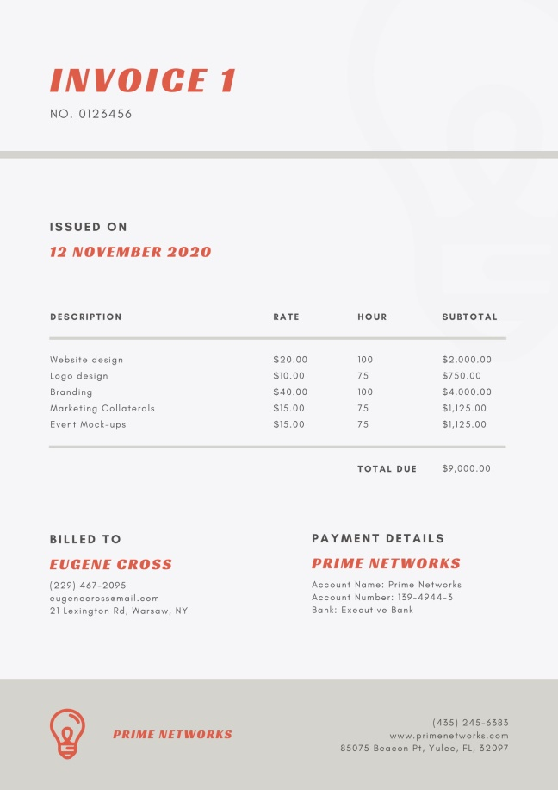
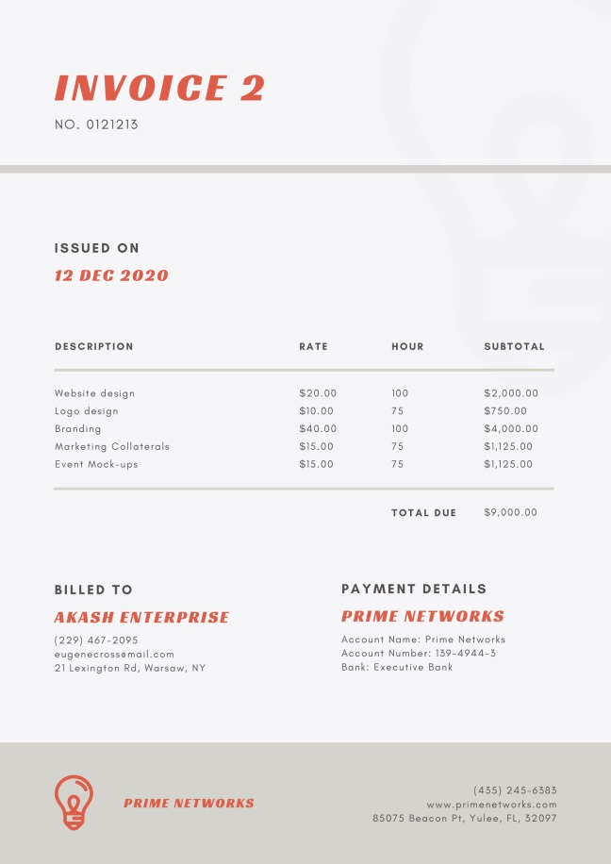
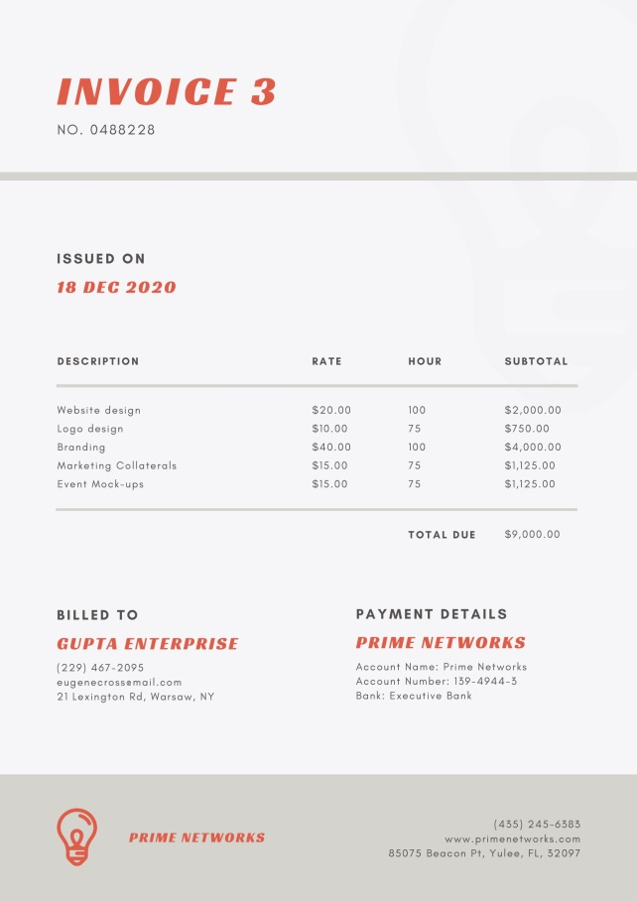
n Number of Invoices
BOT will Process image using OCR and Extract data and will save to variables.

Slide 5
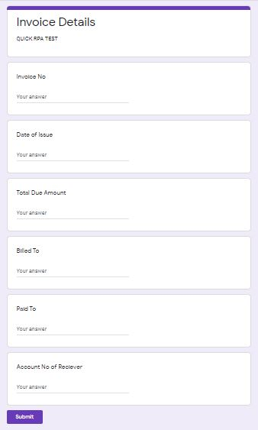
This Google form can be replaced with any web based or local CRM as per the business need.
-------------------------
Conceptual model of the bot will remain almost same for any kind of CRM
This is a sample Google form considered as CRM to simulate the processing of BOT
DATA Captured from the Invoices [image files] will then be loaded automatically by capturing respective input fields present in CRM.
This BOT is Resilient Enough to load data on Dynamic and static web based CRM as well.

